Slide 1
Design Patterns Decorator and Prototype Patterns
Lecture 5
Teacher: Baida’a Lala’a

Slide 2
Decorator Pattern

Slide 3
Decorator is a structural design pattern that lets you attach new behaviors to objects by placing these objects inside special wrapper objects that contain the behaviors.
The decorator pattern adds extensibility without modifying the original object.

Slide 4
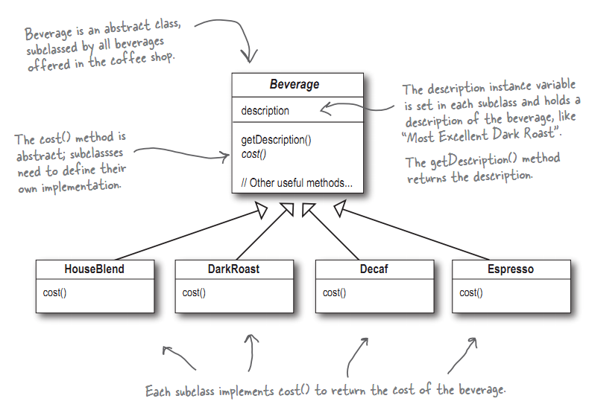
Decorators
Whip
Soy
Milk
Mocha
Caramel

Slide 5
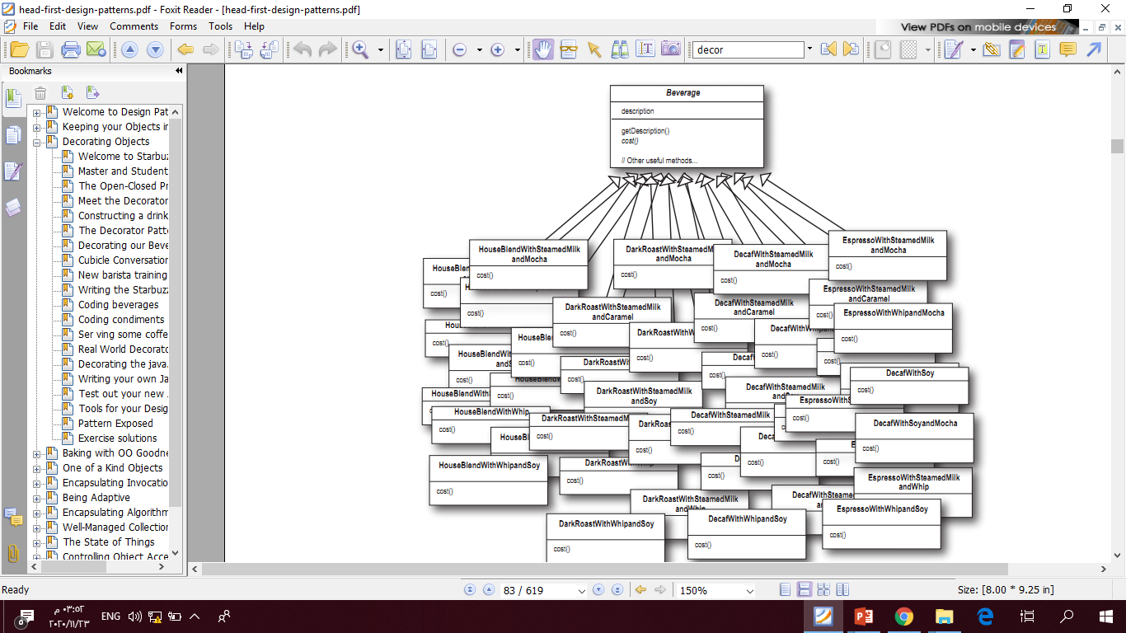
Explosion of subclasses.

Slide 6
Extending a class is the first thing that comes to mind when you need to alter an object’s behavior. However, inheritance has several serious caveats that you need to be aware of.
Inheritance is static. You can’t alter the behavior of an existing object at runtime. You can only replace the whole object with another one that’s created from a different subclass.
Subclasses can have just one parent class. In most languages, inheritance doesn’t let a class inherit behaviors of multiple classes at the same time.

Slide 7
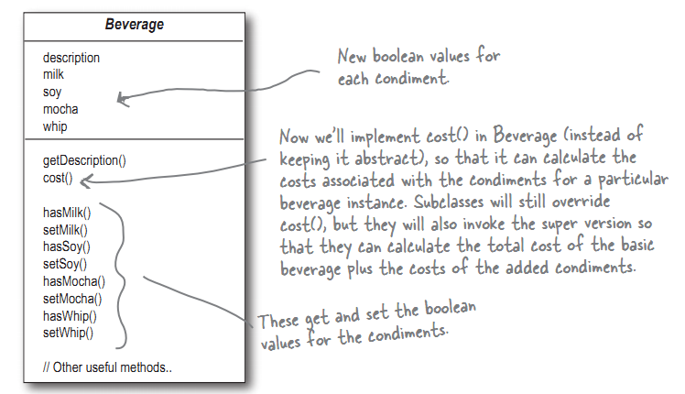

Slide 8
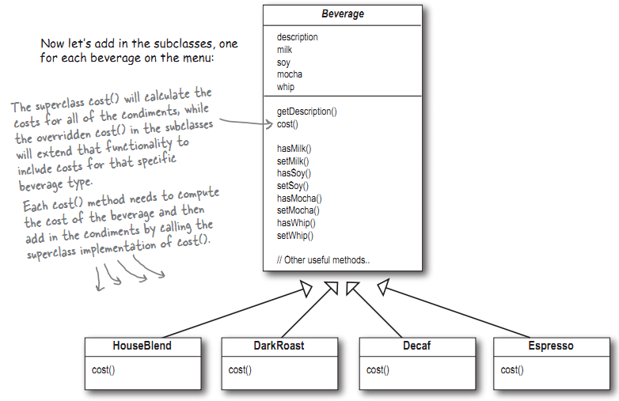

Slide 9
“Wrapper” is the alternative nickname for the Decorator pattern that clearly expresses the main idea of the pattern. A wrapper is an object that can be linked with some target object. The wrapper contains the same set of methods as the target and delegates to it all requests it receives. However, the wrapper may alter the result by doing something either before or after it passes the request to the target.

Slide 10
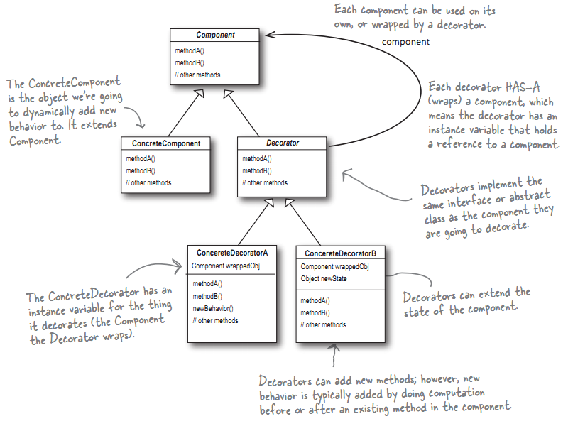

Slide 11
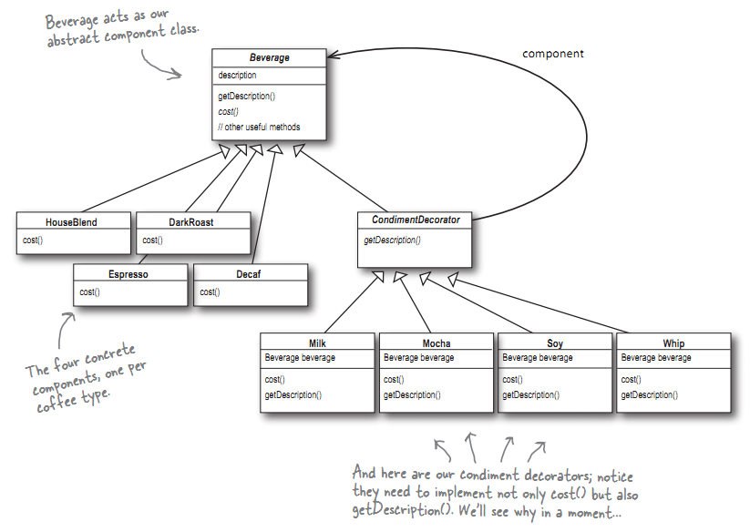

Slide 12
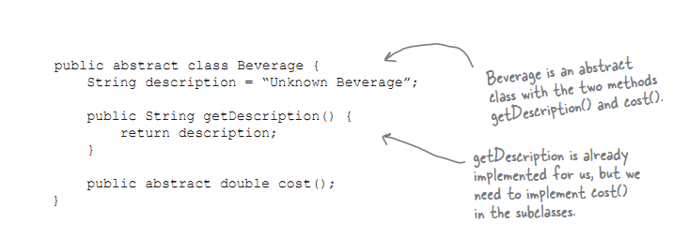

Slide 13
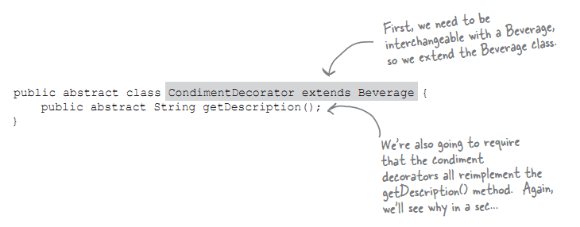

Slide 14
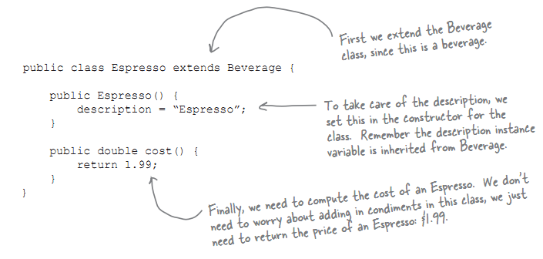

Slide 15
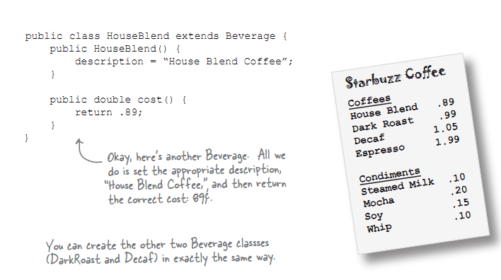

Slide 16
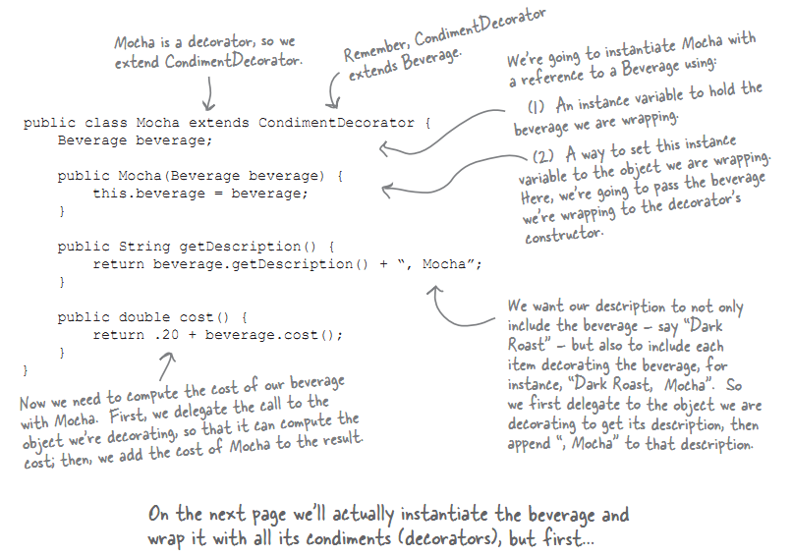

Slide 17
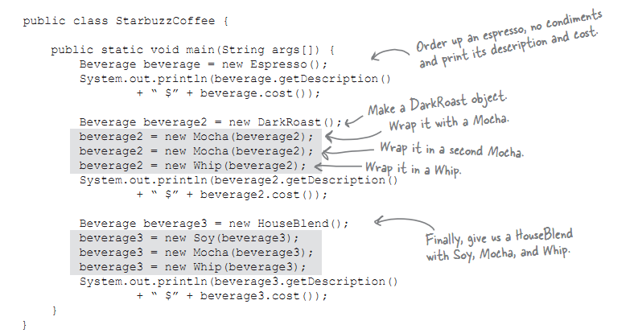

Slide 18
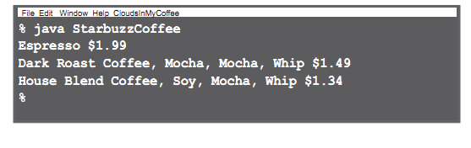

Slide 19
Example
class Abstract_Coffee(object):
def get_cost(self):
pass
def get_ingredients(self): pass
def get_tax(self):
return 0.1*self.get_cost()
class Concrete_Coffee(Abstract_Coffee):
def get_cost(self):
return 1.00
def get_ingredients(self):
return 'coffee'

Slide 20
class Abstract_Coffee_Decorator(Abstract_Coffee):
def__init__(self,decorated_coffee): self.decorated_coffee = decorated_coffee
def get_cost(self):
return self.decorated_coffee.get_cost()
def get_ingredients(self):
return self.decorated_coffee.get_ingredients()

Slide 21
class Sugar(Abstract_Coffee_Decorator):
def __init__(self,decorated_coffee): Abstract_Coffee_Decorator.__init__(self,decorated_coffee)
def get_cost(self):
return self.decorated_coffee.get_cost()
def get_ingredients(self):
return self.decorated_coffee.get_ingredients() + ', sugar'

Slide 22
class Milk(Abstract_Coffee_Decorator):
def __init__(self,decorated_coffee): Abstract_Coffee_Decorator.__init__(self,decorated_coffee)
def get_cost(self):
return self.decorated_coffee.get_cost() + 0.25
def get_ingredients(self):
return self.decorated_coffee.get_ingredients() + ', milk’
class Vanilla(Abstract_Coffee_Decorator):
def __init__(self,decorated_coffee): Abstract_Coffee_Decorator.__init__(self,decorated_coffee)
def get_cost(self):
return self.decorated_coffee.get_cost() + 0.75
def get_ingredients(self):
return self.decorated_coffee.get_ingredients() + ', vanilla'

Slide 23
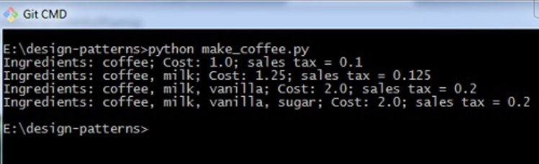
import coffeeshop
myCoffee = coffeeshop.Concrete_Coffee()
print('Ingredients: '+myCoffee.get_ingredients()+ '; Cost: '+str(myCoffee.get_cost())+'; sales tax = '+str(myCoffee.get_tax()))
myCoffee = coffeeshop.Milk(myCoffee)
print('Ingredients: '+myCoffee.get_ingredients()+ '; Cost: '+str(myCoffee.get_cost())+'; sales tax = '+str(myCoffee.get_tax()))
myCoffee = coffeeshop.Vanilla(myCoffee)
print('Ingredients: '+myCoffee.get_ingredients()+ '; Cost: '+str(myCoffee.get_cost())+'; sales tax = '+str(myCoffee.get_tax()))
myCoffee = coffeeshop.Sugar(myCoffee)
print('Ingredients: '+myCoffee.get_ingredients()+ '; Cost: '+str(myCoffee.get_cost())+'; sales tax = '+str(myCoffee.get_tax()))

Slide 24

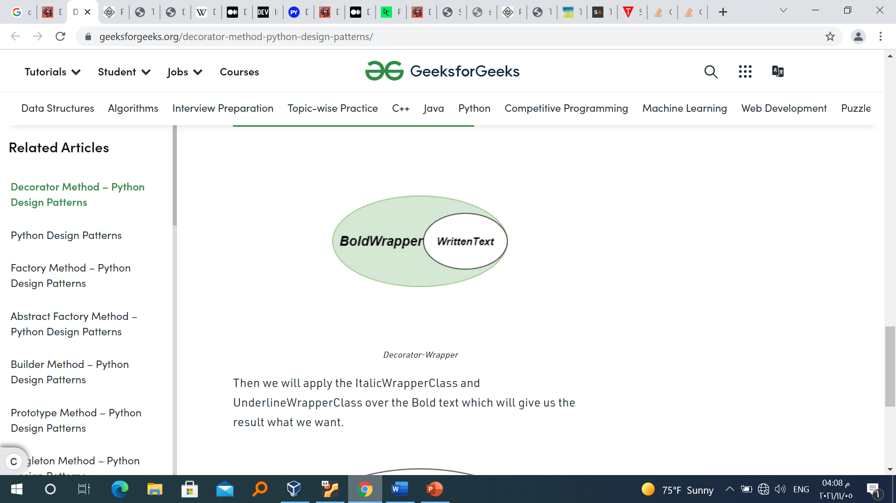
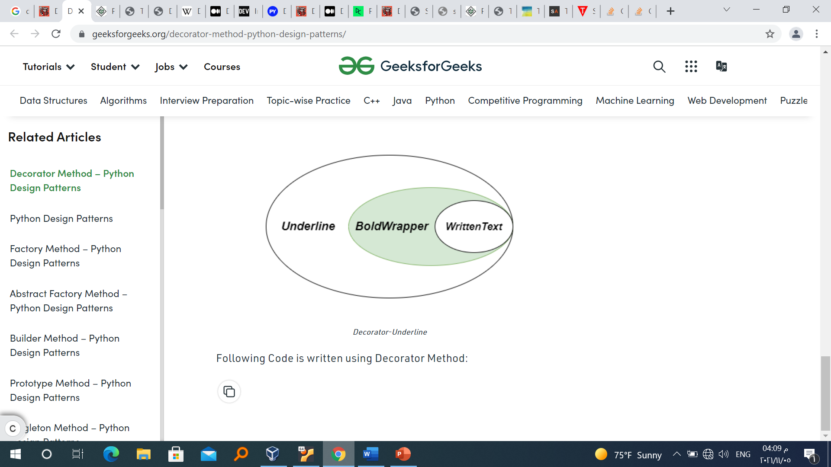
Example
We have only WrittenText but we have to apply filters like BOLD, ITALIC, UNDERLINE. So, we will create separate wrapper classes for each function like BoldWrapperClass, ItalicWrapperClass, and UnderlineWrapperclass.
First, we will call BoldWrapperclass over the Written
text which ultimately converts the text into BOLD letters
Then we will apply the ItalicWrapperClass and UnderlineWrapperClass over the Bold text which will give us the result what we want.

Slide 25
class ItalicWrapper(WrittenText):
"""Wraps a tag in <i>"""
def __init__(self, wrapped):
self._wrapped = wrapped
def render(self):
return "<i>{}</i>".format(self._wrapped.render())
class BoldWrapper(WrittenText):
"""Wraps a tag in <b>"""
def __init__(self, wrapped):
self._wrapped = wrapped
def render(self):
return "<b>{}</b>".format(self._wrapped.render())
class WrittenText:
"""Represents a Written text """
def __init__(self, text):
self._text = text
def render(self):
return self._text
class UnderlineWrapper(WrittenText):
"""Wraps a tag in <u>"""
def __init__(self, wrapped):
self._wrapped = wrapped
def render(self):
return "<u>{}</u>".format(self._wrapped.render())

Slide 26
Change this example to be more general using Interface
""" main method """
if __name__ == '__main__':
before_gfg = WrittenText("GeeksforGeeks")
after_gfg = ItalicWrapper(UnderlineWrapper(BoldWrapper(before_gfg)))
print("before :", before_gfg.render())
print("after :", after_gfg.render())

Slide 27
Prototype Pattern

Slide 28
Prototype Pattern
The Prototype Pattern is a Creational Design Pattern used to clone a Prototype Object, which is a superclass defining fundamental properties. Naturally, the subclasses have the same fundamental properties, with some of their own particular ones.
The Prototype Design Pattern is typically applied when cloning is a cheaper operation than creating a new object and when the creation necessitates long, expensive calls. These calls are commonly tied to expensive database operations, but can be other expensive processes.

Slide 29
Prototype Pattern suggests creating an interface that creates a clone of the existing object. An object that any client can feed upon.
The Prototype Pattern is used when the object creation is costly and requires a lot of time and resources. So Prototype Pattern provides a mechanism to copy the original object to a new object and then modifies it according to our needs.

Slide 30
Shallow And Deep Copy
A shallow copy will just copy the references to non-primitive fields, such as dictionaries, lists, sets or other classes.
A deep copy will create new instances, with the same data.
This means that for shallow copies - you might end up changing the fields of multiple classes instead of one, since multiple objects may share the same field through the same reference.

Slide 31
The shallow copy only copies collections (list, dictionary, set) one level deep.
Deep copy collections containing inner collections, such as lists of lists, or dictionaries of lists, sets and tuples of any combination, etc.

Slide 32
The Prototype: The superclass and will contain all the base obligatory attributes and methods that the clones will have when they copy the Prototype class. Also, the Prototype has an abstract clone() method, which has to be implemented by all subclasses.
Concrete Class(es): Once we have created the Prototype, we can start defining the concrete classes based on it. The concrete classes can have their own attributes and methods but they’ll always have the original prototype attributes and an overwritten version of the clone().

Slide 33
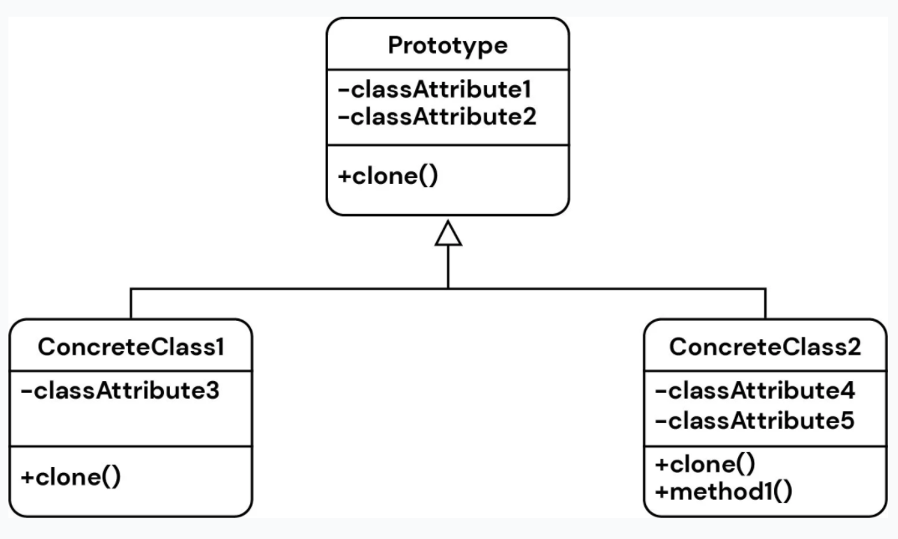

Slide 34
We'll be creating a couple of NPC(nonplayer character) types for a fictional video game - a Shopkeeper, a Warrior and a Mage.
Each of them are an NPC, a common superclass - but they'll have different attributes. The Shopkeeper has charisma, so they can barter better, while the Mage has mana instead of stamina, like the Warrior does.
Our Prototype class will signify general NPCs and from it, we can implement our concrete classes. We'll have delays in both the Prototype constructor and the concrete classes themselves, mocking an expensive call in the constructor - delaying the code execution by several seconds, making the creation of any new objects an extremely expensive operation.

Slide 35
Defining the Prototype Class
Let's start off with the superclass - the Prototype for the NPCs. Its clone() method will be empty, but its subclasses will implement it. Naturally, it'll also contain all of the base attributes for the subclasses. Since we want all subclasses to necessarily implement the clone() method, it's marked as an @abstractmethod. The annotation stems from the ABC library and abstract methods don't provide an implementation, but have to be implemented by subclasses:

Slide 36
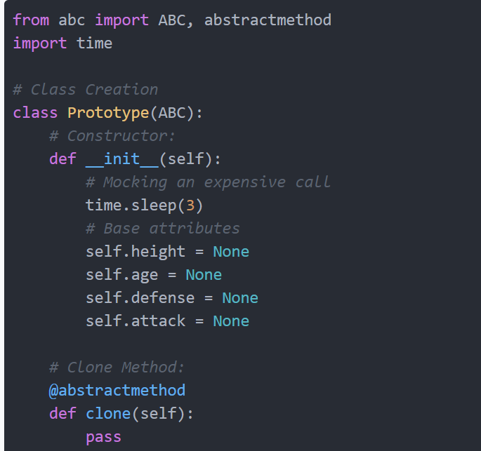

Slide 37
Concrete Classes
Now, let's define our concrete classes based on the Prototype. We'll be overriding the clone() method and actually provide an implementation for it. To copy the objects, we'll make use of the copy library, which is built-in into Python.
The copy() method of the library performs a shallow copy of an object,
while a deepcopy() creates a deep copy of an object. Depending on the structure of your objects - you'll prefer one or the other.

Slide 38
Shallow copies are cheaper operations, since they don't instantiate anything new for non-primitive types. In general, these types might not be expensive to instantiate, so you won't gain much. But, if you class has expensive fields as well - those that take time to instantiate, a shallow copy will be much more performant than a deep copy, at the cost of sharing the same objects in memory.
That being said, let's define our subclasses. Instead of accepting values through the constructor, we'll supply some base-values for all instances of these concrete classes:

Slide 39
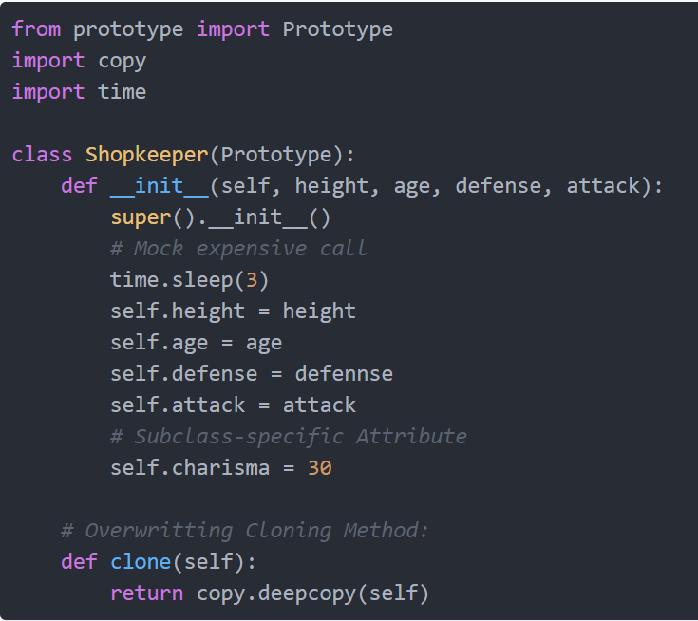

Slide 40
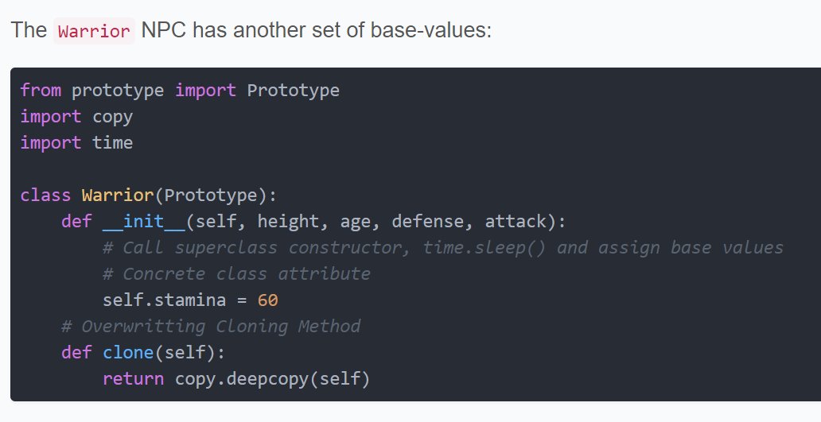

Slide 41
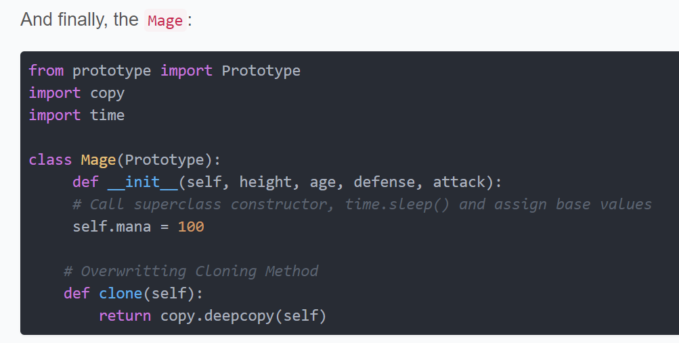

Slide 42
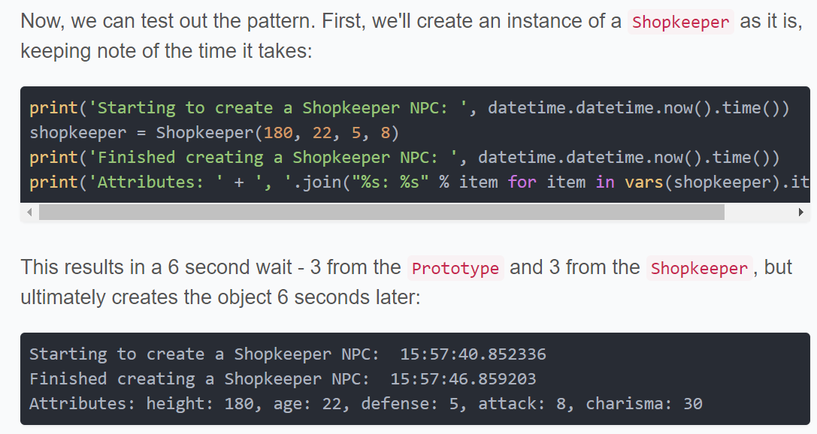

Slide 43
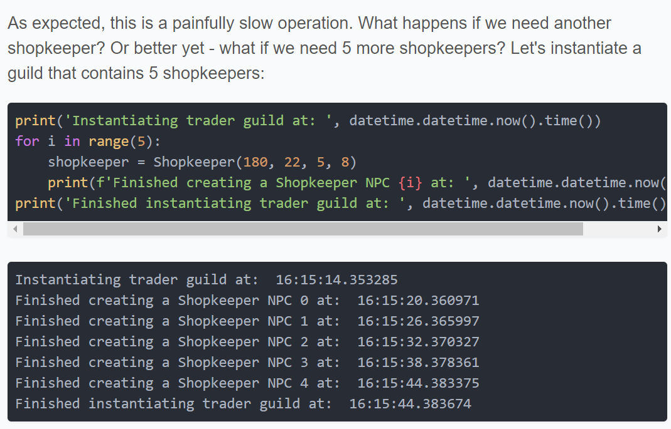

Slide 44
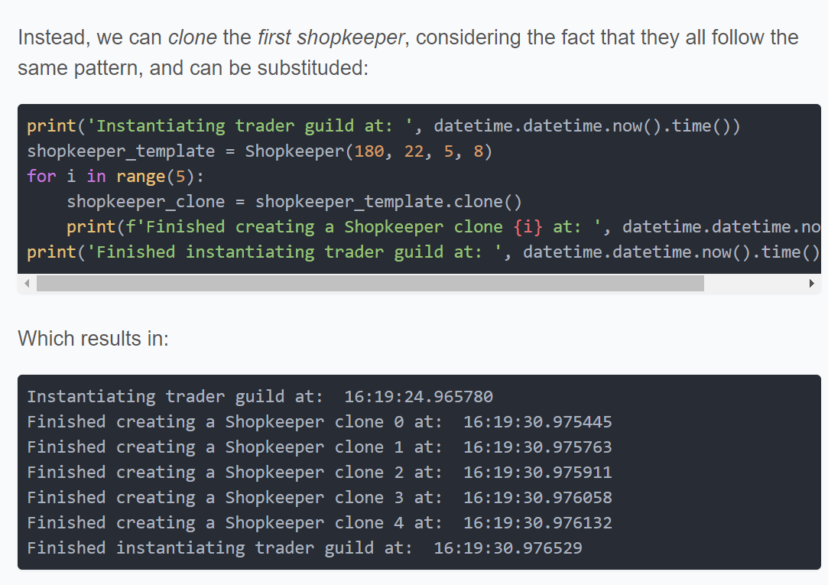

Slide 45
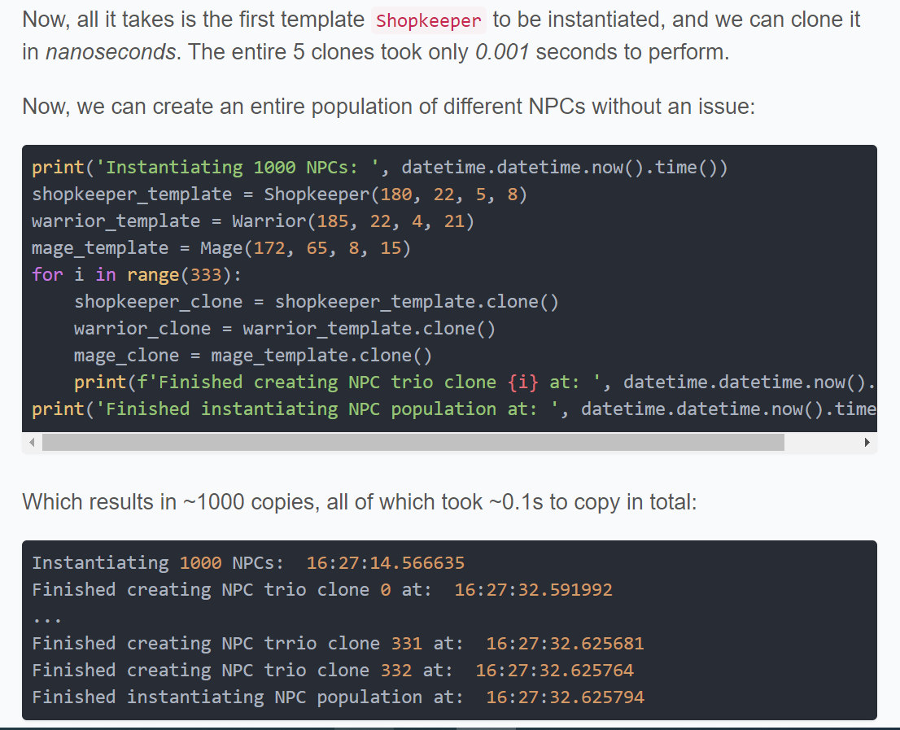
Conclusion
Creating complex objects, especially if they require expensive database calls is time-consuming.

Slide 46
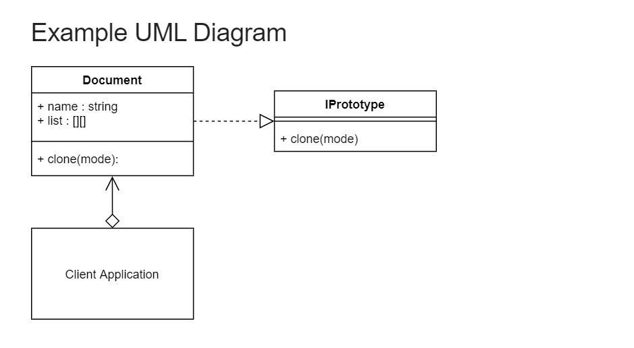

Slide 47
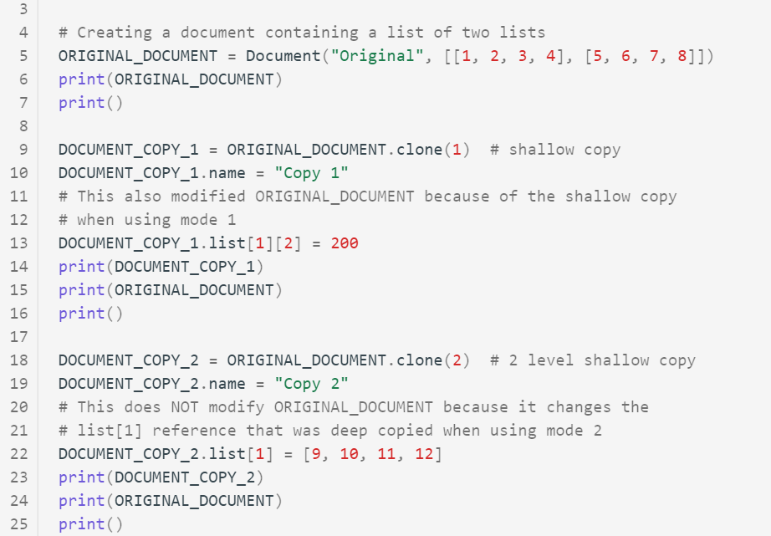
./prototype/client.py

Slide 48
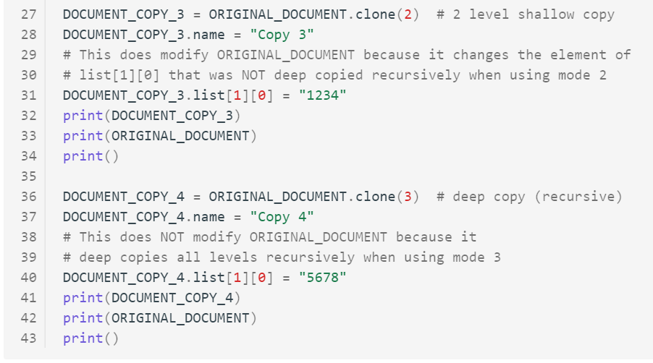

Slide 49
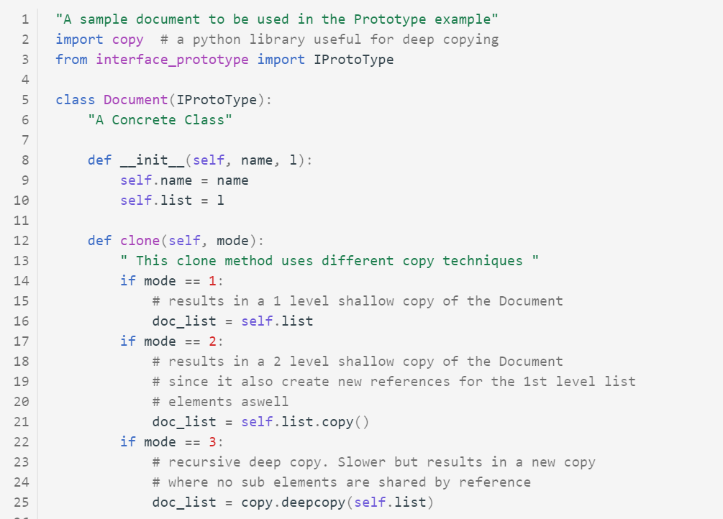

Slide 50
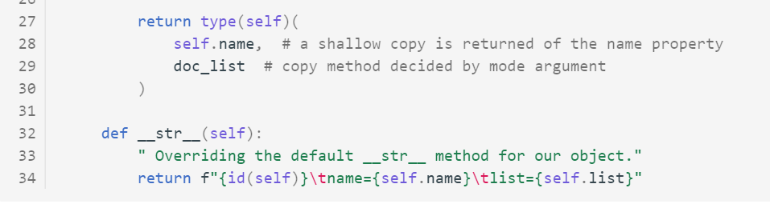

Slide 51
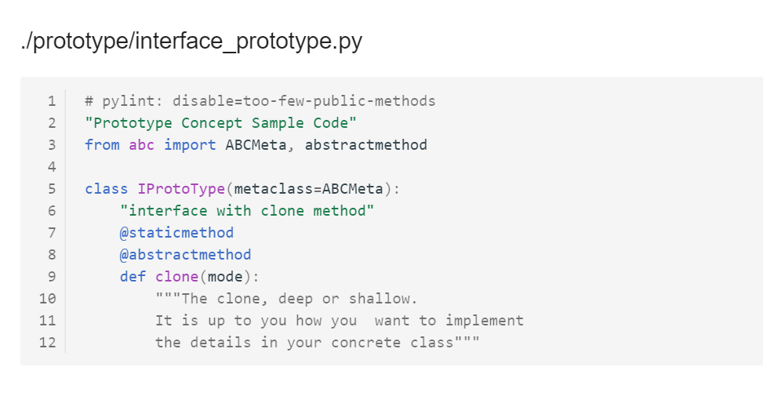

Slide 52
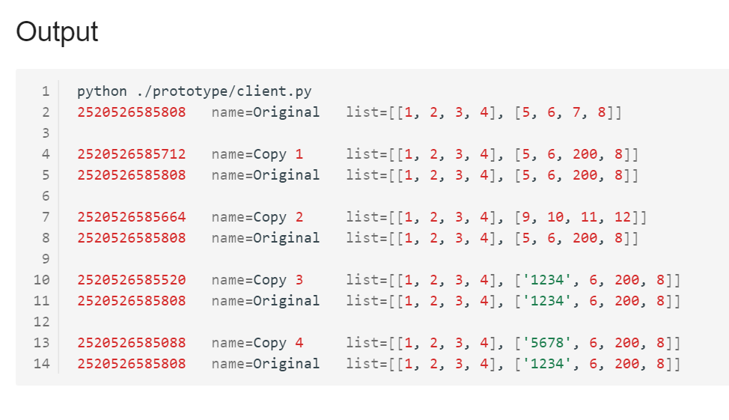

Slide 53
Python id() Function
The Python id() function returns the memory address of an object.
All objects in Python will have a memory address.
You can test if an object is unique in Python by comparing its ID.
In the examples above, I can tell how deep the copies of the dictionaries and lists were, because the IDs of the inner items will be different. I.e., they point to different memory identifiers.
Note that every time you start a Python process, the IDs assigned at runtime will likely be different.

